Slide 1

POULTRY SCIENCE:
Farm To Fork
Unit 14

Slide 2
Poultry Science:
Farm To Fork
Unit 14: Segment 1
Processing

Slide 3
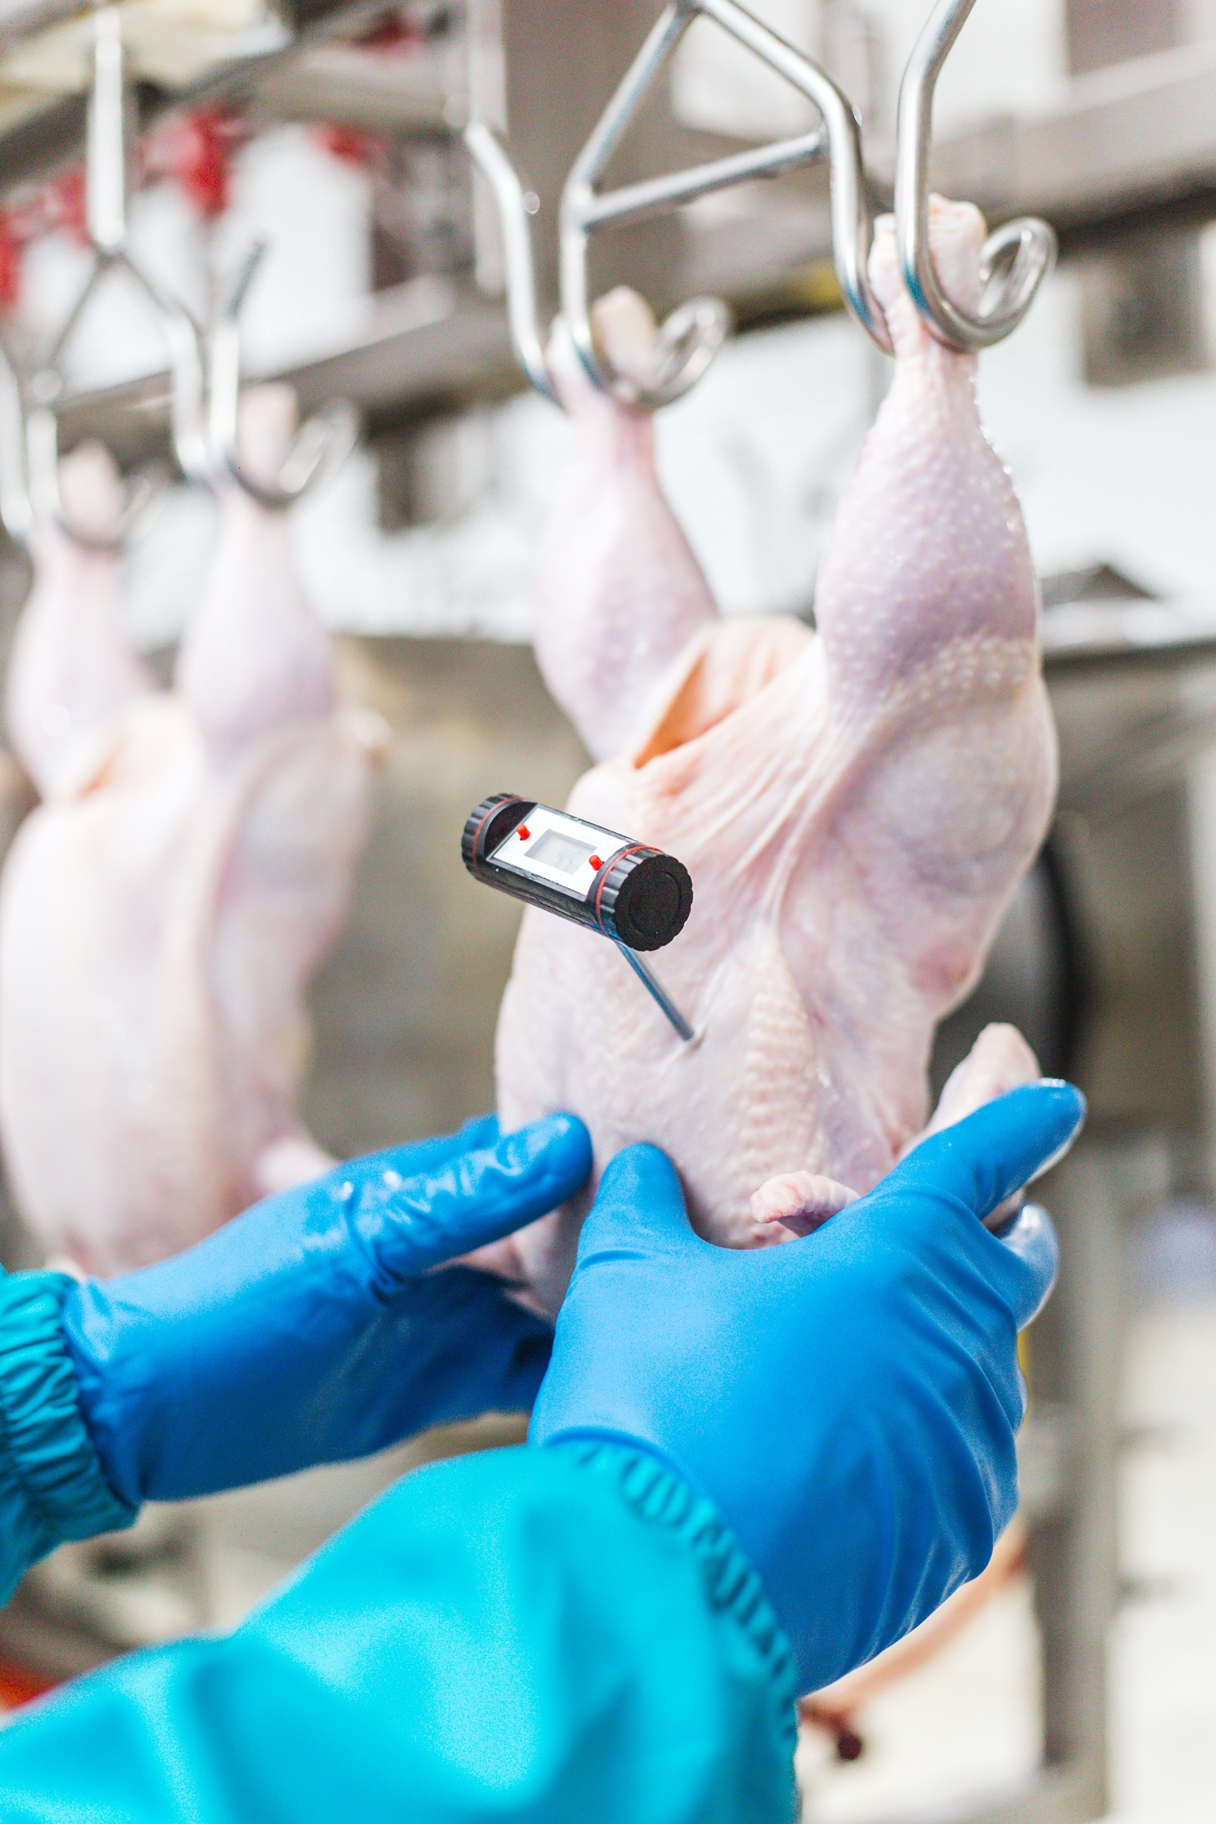
Poultry Processing Steps
Shackling
Stunning
Bleeding
Scalding
Picking
Removal of Feet, Head, Neck, & Oil Glands
Evisceration
Carcass Washing
Chilling
Cut-up & Deboning
Storage

Slide 4
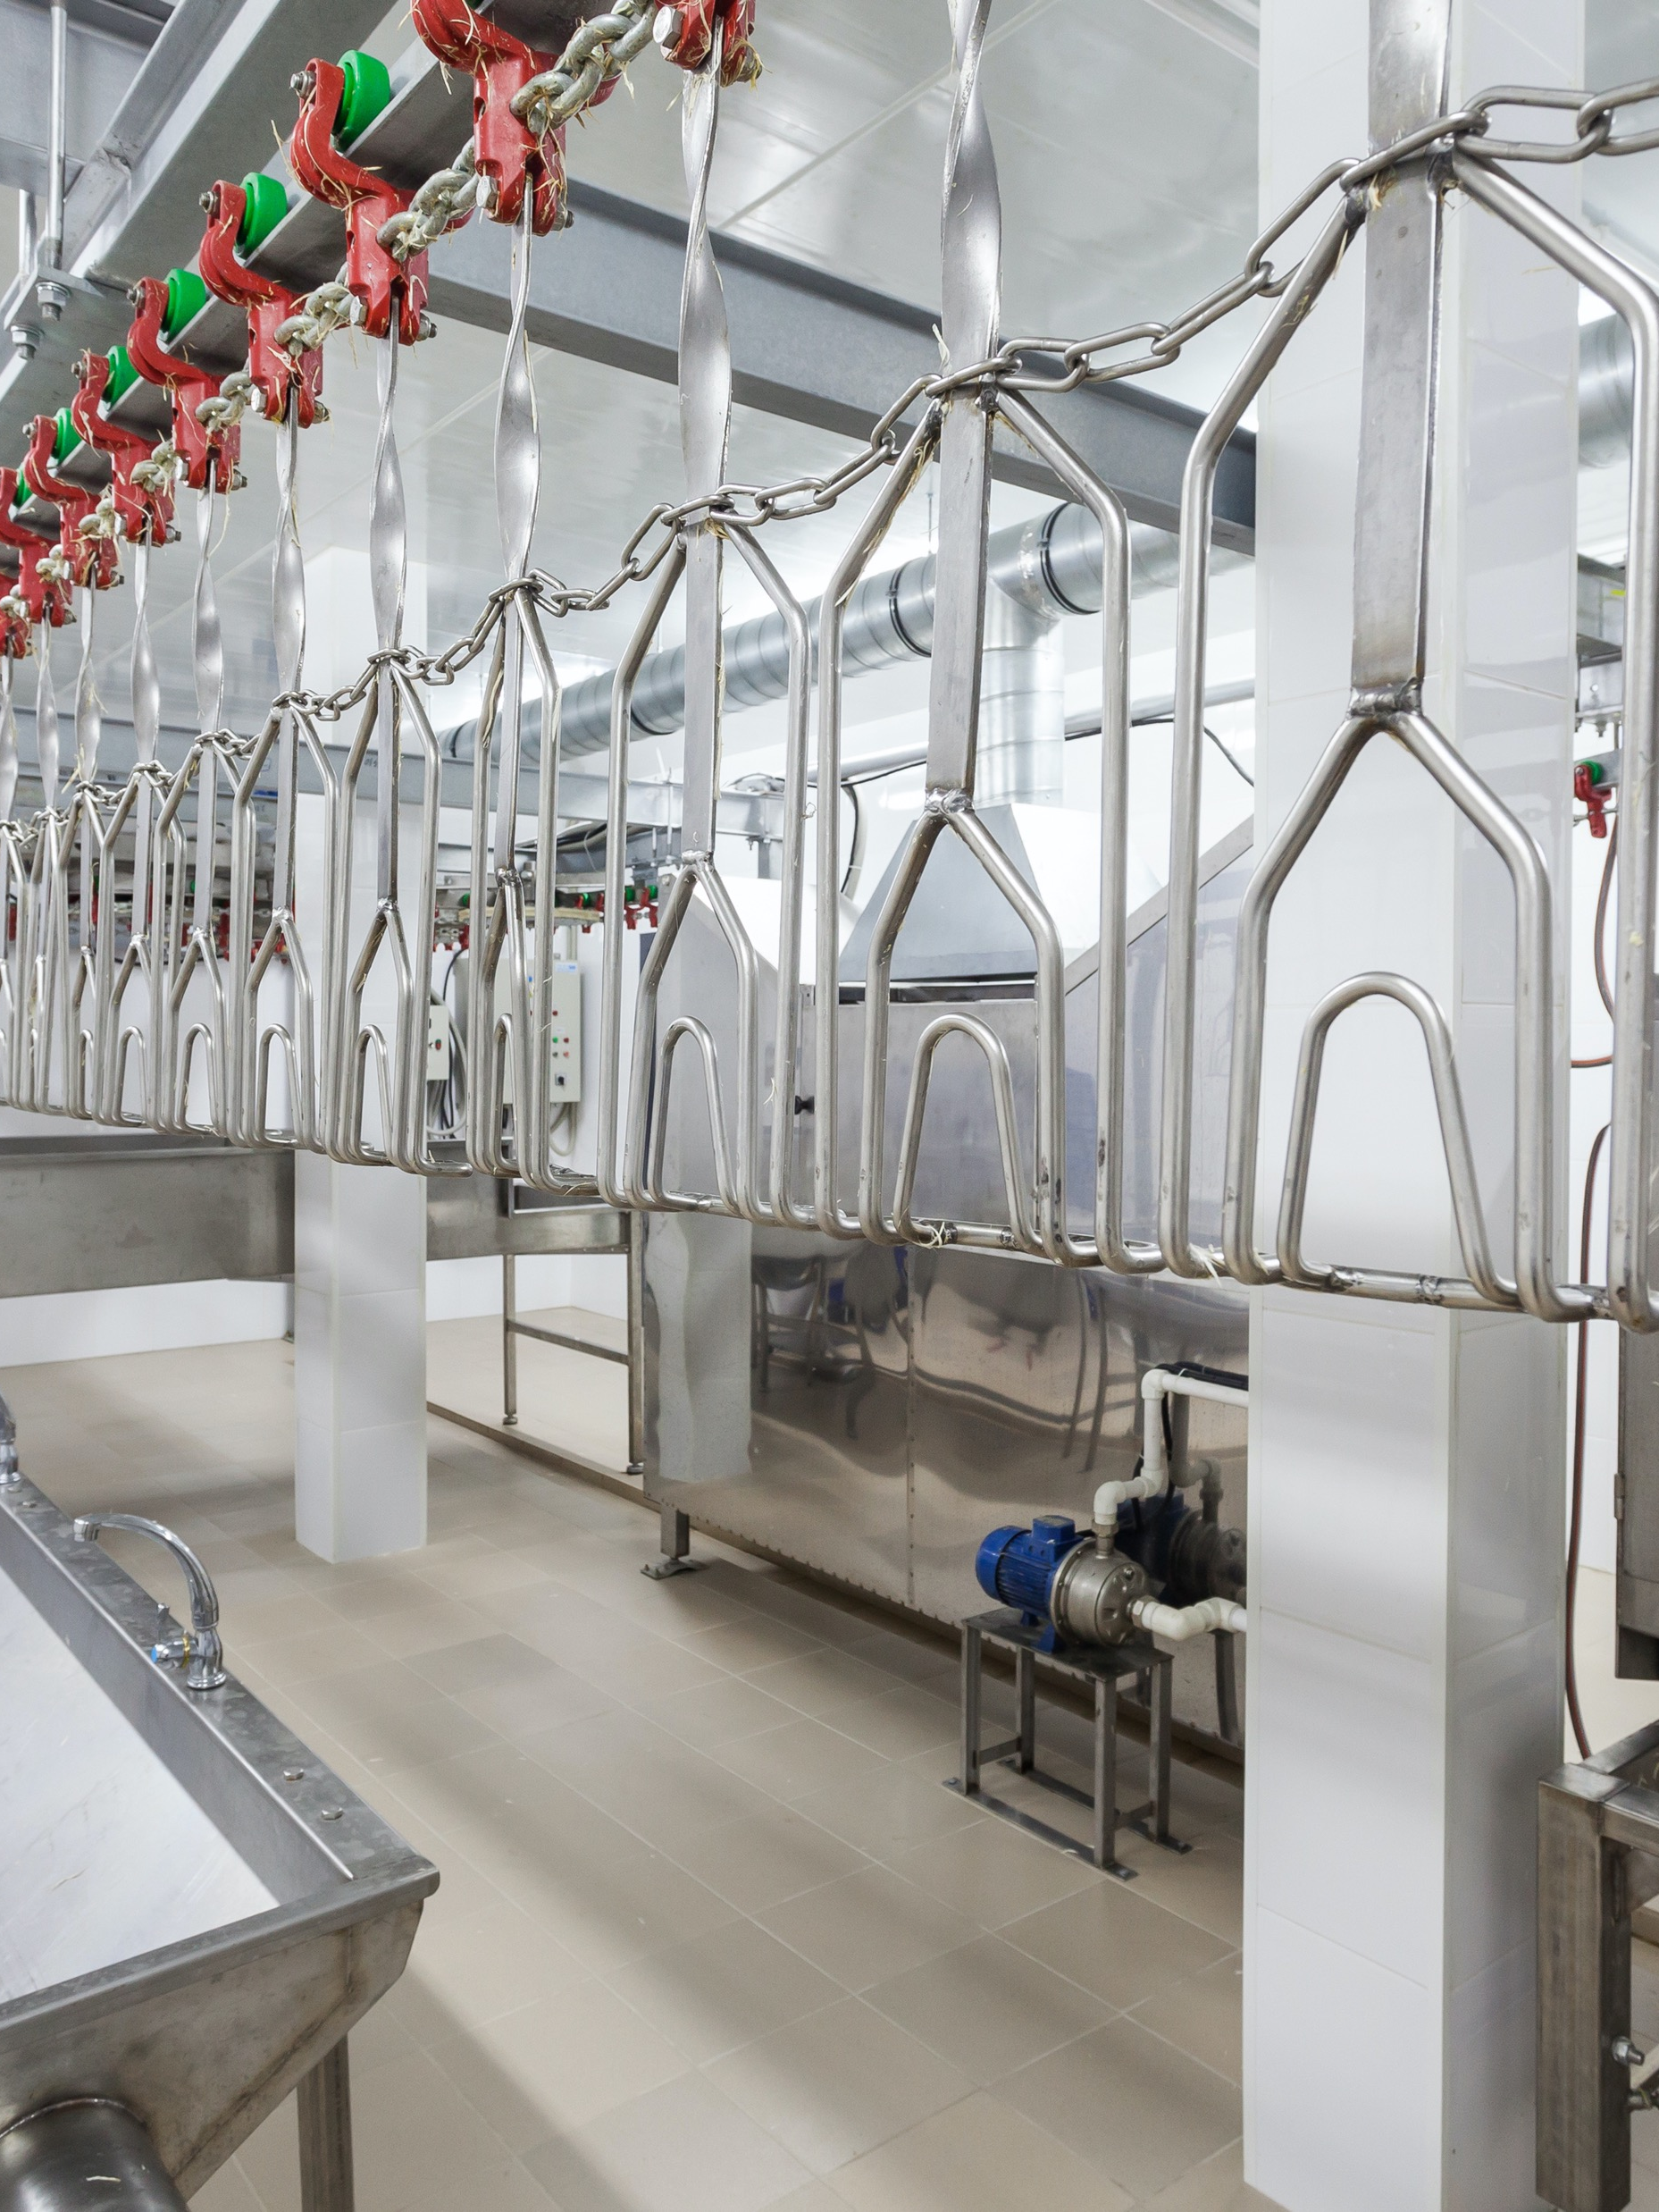
Step 1: Shackling
Poultry meat processing is initiated by hanging, or shackling, the birds to a processing line.
Birds are transferred from coops or transport cages to a dark room where they are hung upside down from shackles attached to an automated line.

Slide 5

Step 2: Stunning
Electrical stunning delivers a current through a water bath to immediately create a state of unconsciousness. For a complete stun, the birds must receive a particular electric exposure for a specified time.
  An effective stun will cause the bird to arch the neck, hold the wings tightly to the body, and may sometimes result in body tremors.
  The stun will render the bird unconscious immediately and lasting until the bird has been killed.
  The current should be compliant with minimum recommended current per bird.
Controlled environment stunning is another alternative stunning process where birds are immersed in an approved gas or mixture of gases (i.e. CO₂) in order to displace oxygen and render the bird unconscious.

Slide 6
Step 3: Bleeding
After stunning, the birds are passed through an automated knife that makes an incision on the neck to cut the major blood vessels in the neck.
With the carcass hanging upside down and the major blood vessels cut, the majority of the blood in the carcass will exit.

Slide 7

Step 4: Scalding
Scalding loosens the feathers to facilitate their removal.
Carcasses are submerged into the scalder that contains water heated from 125-150ºF depending upon the type and age of the poultry.
This hot water temperature serves to loosen the connection of feathers to the skin.

Slide 8
Step 5: Picking
”Picking” is a term that refers to feather removal.
The picker removes the feathers on the carcass and is an automated machine that contains rubber finger-like projections that rotate in a circular motion to remove feathers without damaging the carcass.

Slide 9
Step 6: Removal of Feet, Head, Neck, & Oil Glands
Feet are removed at the ankle joints and are usually shipped to other countries like China where “chicken paws” are commonly consumed.
  Hence one of the reasons behind the importance of foot pad quality – i.e. no ammonia burns, etc.
The head is cut and removed.
The neck is cut with machine and esophagus is exposed.

Slide 10
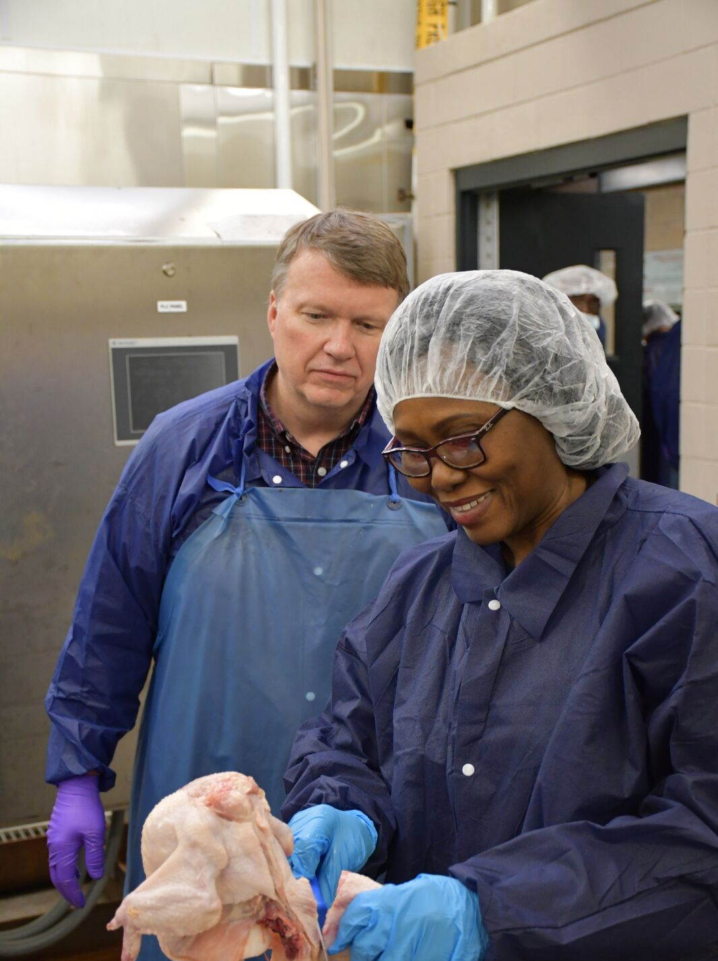
Step 7: Evisceration
Evisceration refers to the removal of internal organs.
The inedible viscera consists of the spleen, esophagus, lungs, intestines, and reproductive organs.
The intestines (viscera) are federally inspected for signs of disease or other problems.
  Identified disease or other problems results in the removal, or condemnation, of the carcass from the processing line.
The edible viscera, or “giblets”, consist of the heart, liver, and gizzard.
  The giblets are packaged in the carcass and sold separately.

Slide 11
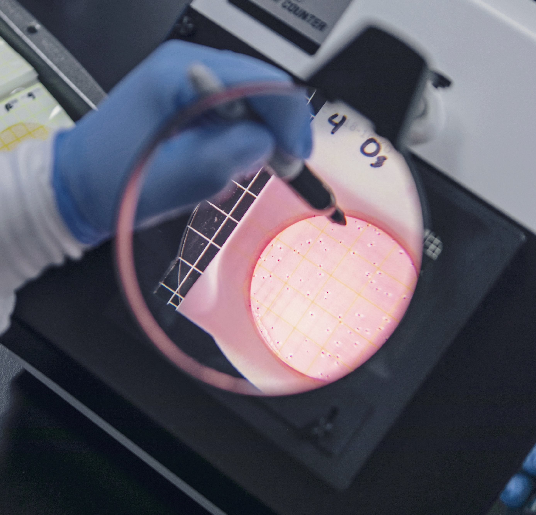
Step 7:
Carcass Washing
The carcasses are cleaned for microbial and visible concerns.
When processing chicken, microbial bacteria such as E. Coli and Salmonella are analyzed.

Slide 12
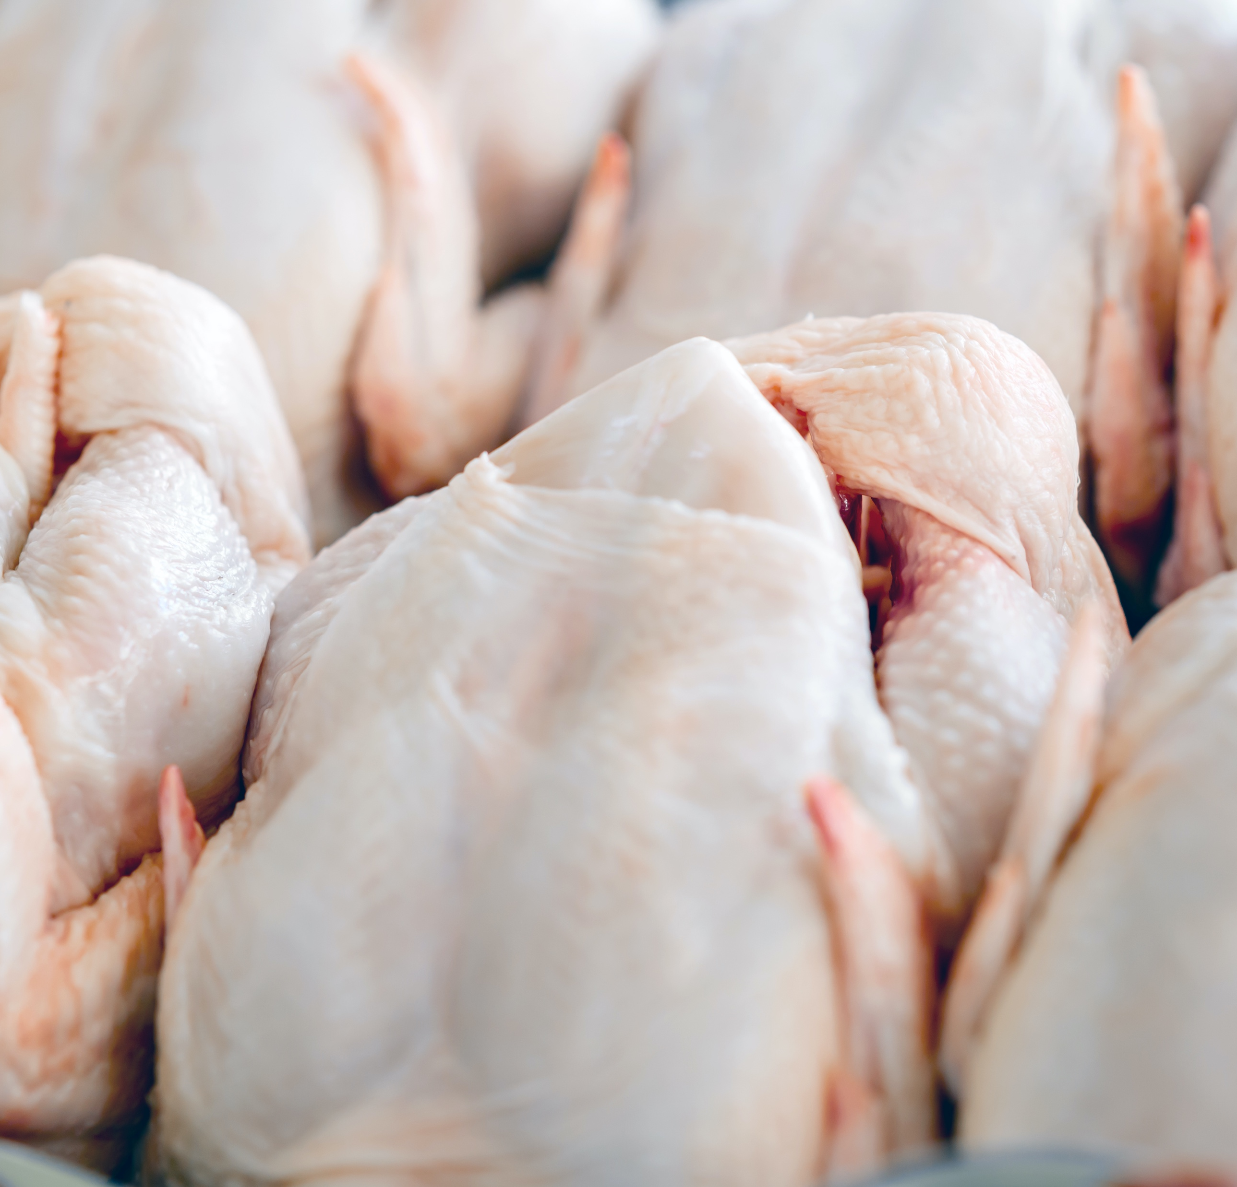
Step 8: Chilling
The carcass temperature must be reduced to prevent microbial growth.
The USDA specifies the amount of chilling for specific bird sizes:
  4 lb. Broiler = 40ºF within 4 Hours
  4-8 lb. Broiler = 40ºF within 6 Hours
  > 8 lb. Broiler = 40ºF within 8 Hours
Submerging the carcass in an ice (chilled water) bath is the most common method of carcass chilling.
Carcasses can also be chilled by air chilling, which occurs by passing cold air over the carcass.
  This is a more expensive process, but some consumers are willing to pay more for air chilling.

Slide 13
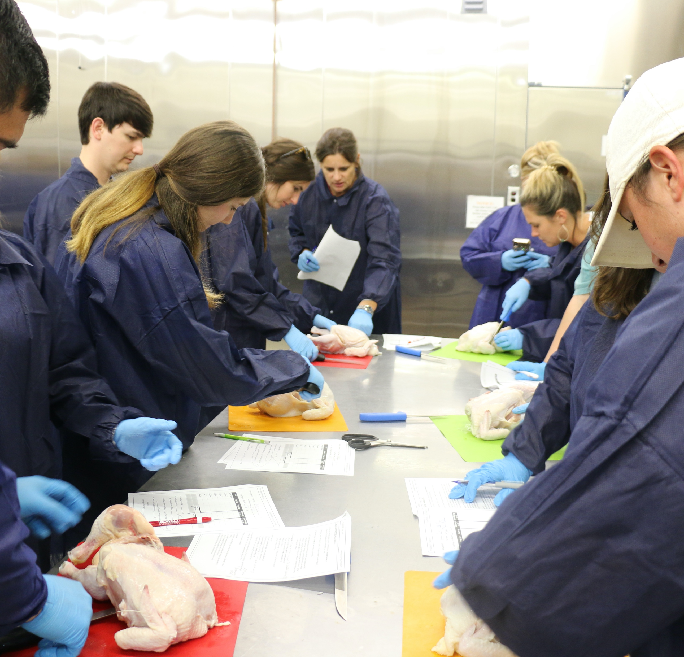
Step 9:
Cut-up & Deboning
On average, 75-80% of the live animal weight is retained in the carcass.
The carcass can be sold whole, or individual components of carcass can be cut-up for individual sale.
  Cut-up usually includes the removal of the breast, thigh, drumstick, and wings.
Deboning refers to the removal of bone from the cut-up meat.
  Breasts and thighs are commonly deboned.

Slide 14
Step 10: Storage
Poultry meat should be refrigerated at approximately 30ºF.
Keeping the poultry below 40ºF reduces the risk of microbial growth.
Refrigeration and freezing does not kill all microbes. Some will survive, which will be covered in one of the following segments of this unit.

Slide 15



Slide 16
Poultry Science:
Farm To Fork
Unit 14: Segment 2
Further Processing

Slide 17

What is
“Further Processing”?
Further processing may include forming, curing, smoking, and cooking of poultry products.

Slide 18
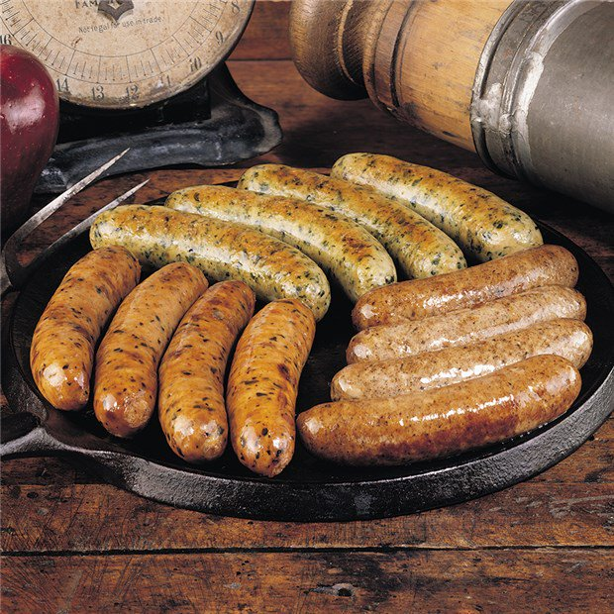
Forming
Forming product requires a change in particle size and often includes the addition of ingredients to add flavor.
Forming product also requires the use of a mold to obtain desired shape.
Formed products include hot dogs, chicken nuggets, or sausage.

Slide 19
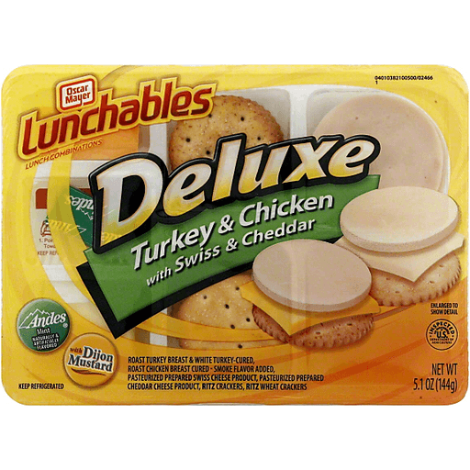
Curing
Curing involves the addition of preservatives, often nitrates, to the meat to improve flavor and product shelf-life.

Slide 20
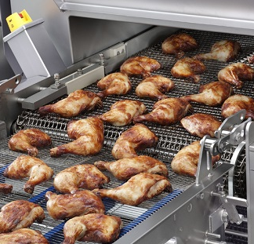
Smoking
Smoking acts as a preservative while providing additional flavor to the product.

Slide 21
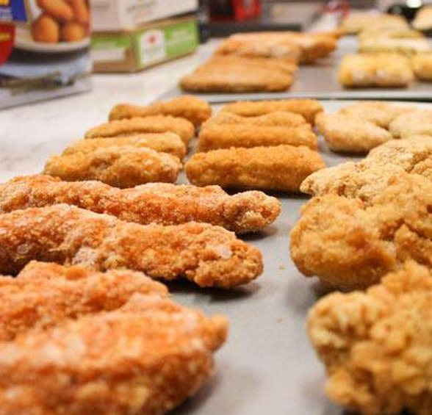
Ready-to-Eat
Product that may be prepared in a form that is edible without additional preparation.

Slide 22
Poultry Science:
Farm To Fork
Unit 14: Segment 3
Food Safety & Regulations

Slide 23
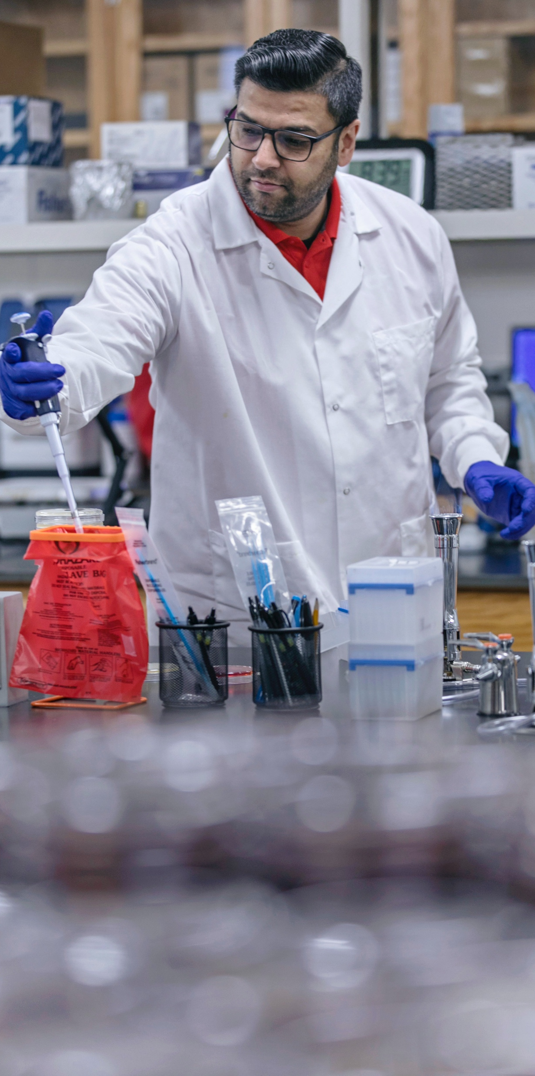
What is HACCP?
Hazard Analysis Critical Control Point (HACCP) - a system of extensive evaluation and control over an entire food production process for the sole purpose of reducing potential food-related health risks to consumers.
Hazard - any biological, physical or chemical property that could cause a product to be unsafe for consumption.
A HACCP program maintains safety and wholesomeness of meat and poultry because potential hazards that may occur during processing are anticipated, evaluated, controlled and prevented.
Processing plants are required to have a HACCP plan for each product.

Slide 24
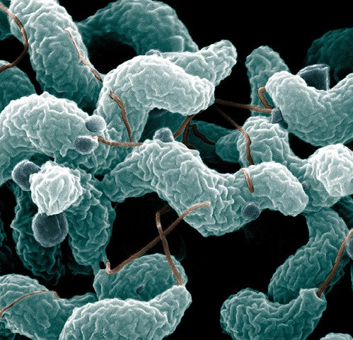
Campylobacter
This bacteria causes an estimated 1.5 million illnesses each year in the U.S.
Infected by eating raw or undercooked poultry (or eating something that touched it), seafood, produce, contact with contaminated animals, and drinking untreated water.
Symptoms begin 2-5 days after infection and can last around 1 week.

Slide 25
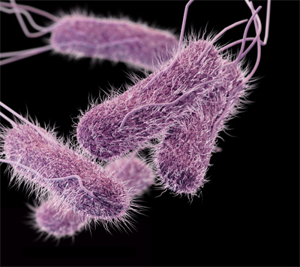
Salmonella
This bacteria causes roughly 1.35 million infections, 26,500 hospitalizations, and 420 deaths in the U.S. per year!
Symptoms usually begin 6 hours to 6 days after infection and last 4-7 days.

Slide 26
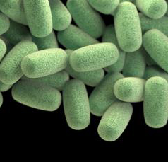
Clostridium perfringens
One of the most common types of foodborne illnesses in the U.S., with the CDC estimating it causes nearly 1 million cases each year!
Spore-forming gram-positive bacterium that is found in many environmental sources, as well as the intestines of humans and animals.
Outbreaks often happen in institutions like hospitals, school cafeterias, prisons, catered events, etc.
Symptoms are usually developed within 6-24 hours after infection and lasts for less than 24 hours.

Slide 27
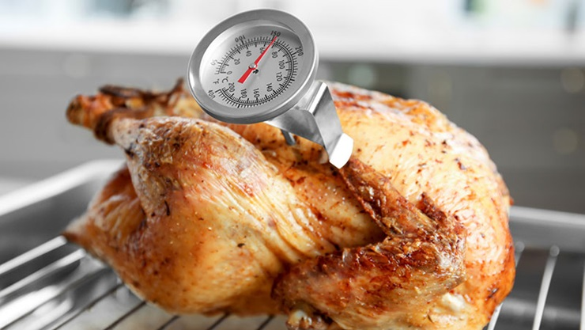
Food Poisoning:
Wait, was that my fault?
Food poisoning tends to be a result of human error during the handling and cooking process of poultry, eggs, and other raw meats.
Following proper food safety precautions and cooking instructions are vital to keeping you and those around you safe and healthy!

Slide 28
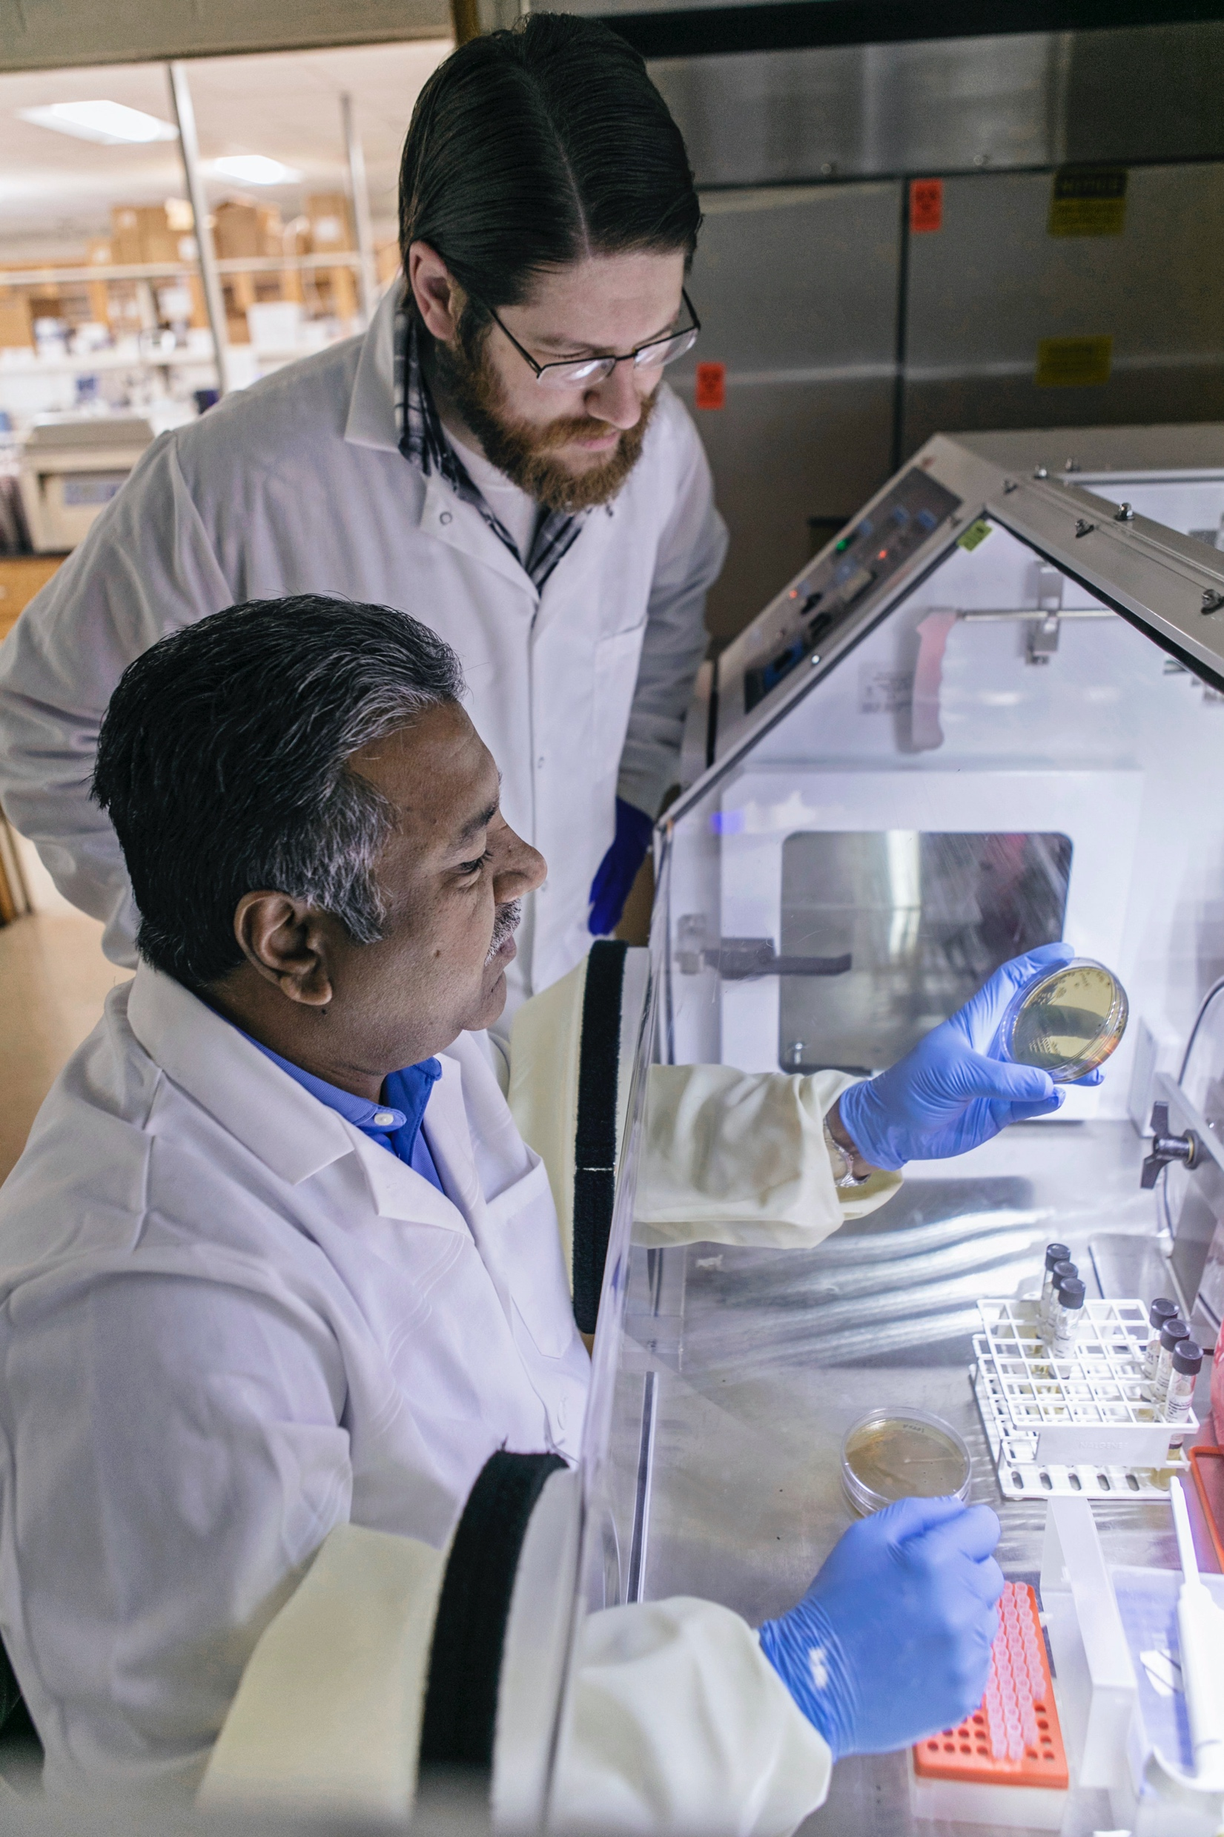
The Food Safety Rulebook:
Place meat in a separate disposable bag before putting in your shopping cart or refrigerator to prevent raw juices from getting onto other foods.
Always wash your hands immediately after handling chicken.
DO NOT WASH RAW CHICKEN.
Use a separate cutting board for raw chicken.
Use a food thermometer to ensure chicken is cooked to a safe internal temperature of 165ºF
Refrigerate or freeze leftover chicken within 2 hours (or within 1 hour if the temperature outside is higher than 90ºF)

Slide 30
Poultry Science:
Farm To Fork
Unit 14: Segment 4
Marketing & Labeling of Poultry Products

Slide 31

What do American consumers want from their food?
Safe
Nutritious
Wide Variety and Selection of Products
Convenience

Slide 32

Consumer Points of Interest
“Environmentally Friendly” Products
“All-Vegetable” Diets
“Organically” Raised
Animal Well-Being
Local Sourcing

Slide 33

Results of Consumer Points of Interest
Premium Priced Products
  Example: USDA Organic, Pasture-Raised, Certified Humane, 1/3 Less Cholesterol, Ethical Eggs from Happy Hens Raised on Native Grasses
  Approximately $8.69 per dozen
+20% increase in specialty products over the last decade
  Still less than 2% market share

Slide 34
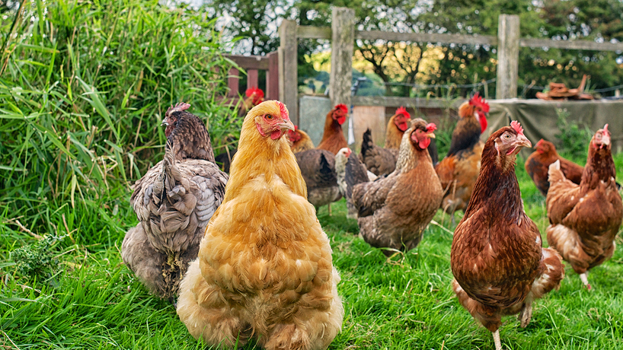
Urban Myths & Legends Surrounding Home-Grown Products
Reduced Cholesterol ->
  Eggs are eggs!
Healthier and Safer ->
  Bacteria and viruses are more prevalent in the backyard
  Often inadequate nutrition for the backyard flock
Hormone-Free ->
  Genetics, environmental improvements, and nutrition have made the modern bird, NOT HORMONES.
  It has been against federal law to use hormones in poultry production since the 1950’s…they have never been used in poultry production.

Slide 35
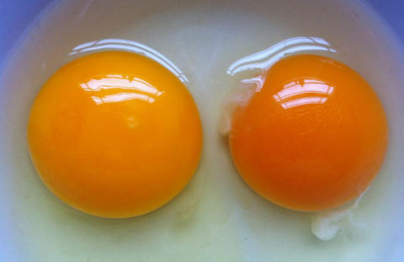
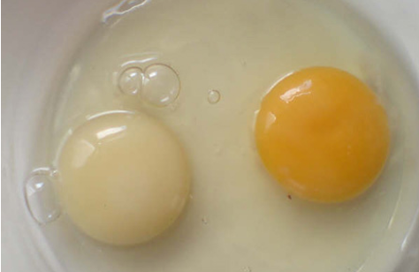
Urban Myths &
Legends Surrounding Home-Grown Products
Fresher ->
  Most commercial eggs are just as fresh due to high demand.
Better Flavor ->
  ”You are what you eat”…flavor and color are feed-dependent.
  Nutritional value is the same regardless.
Cheaper ->
  Production costs significantly higher (1st year of backyard flock will cost $8-12 per dozen) due to the purchasing and acquisition of everything needed for a flock.

Slide 36
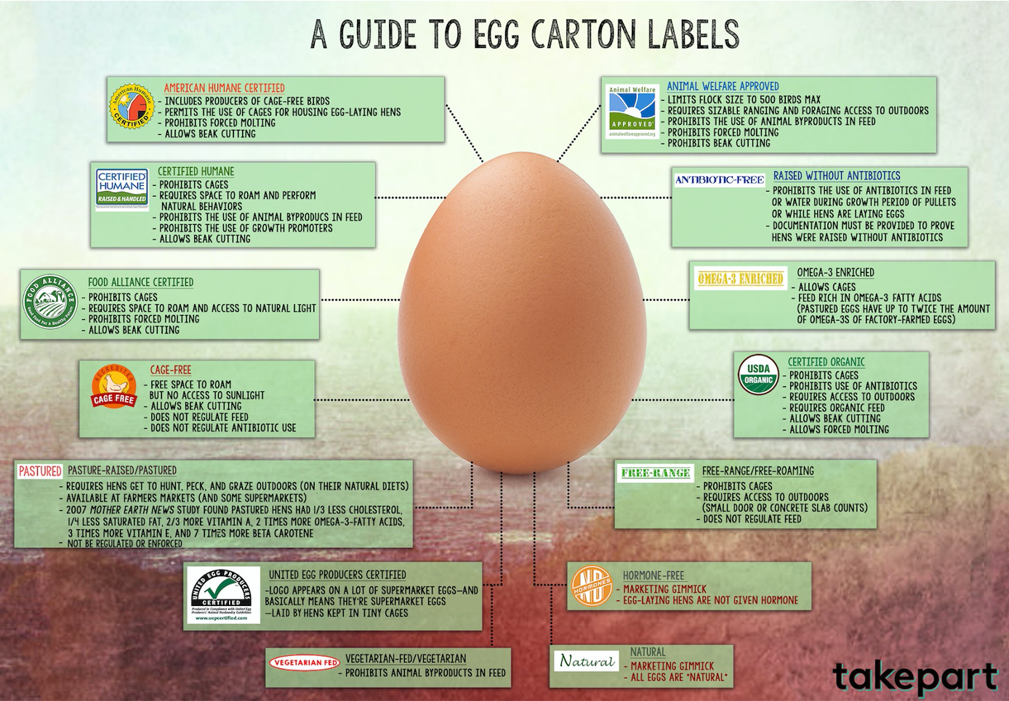

Slide 37
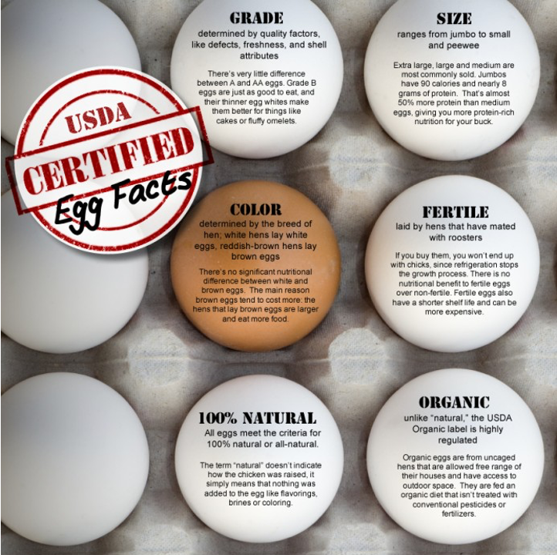
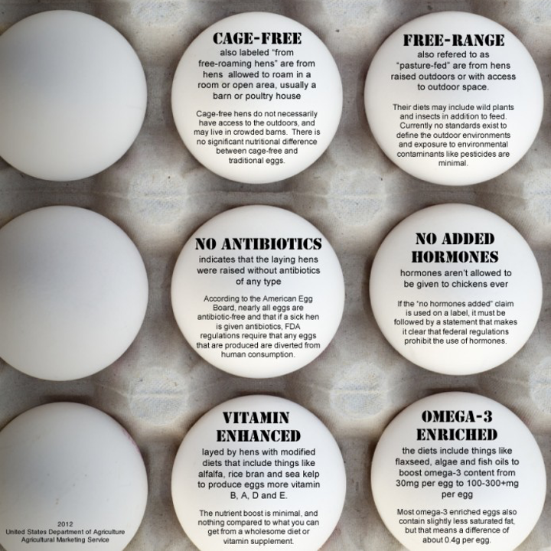

Slide 38
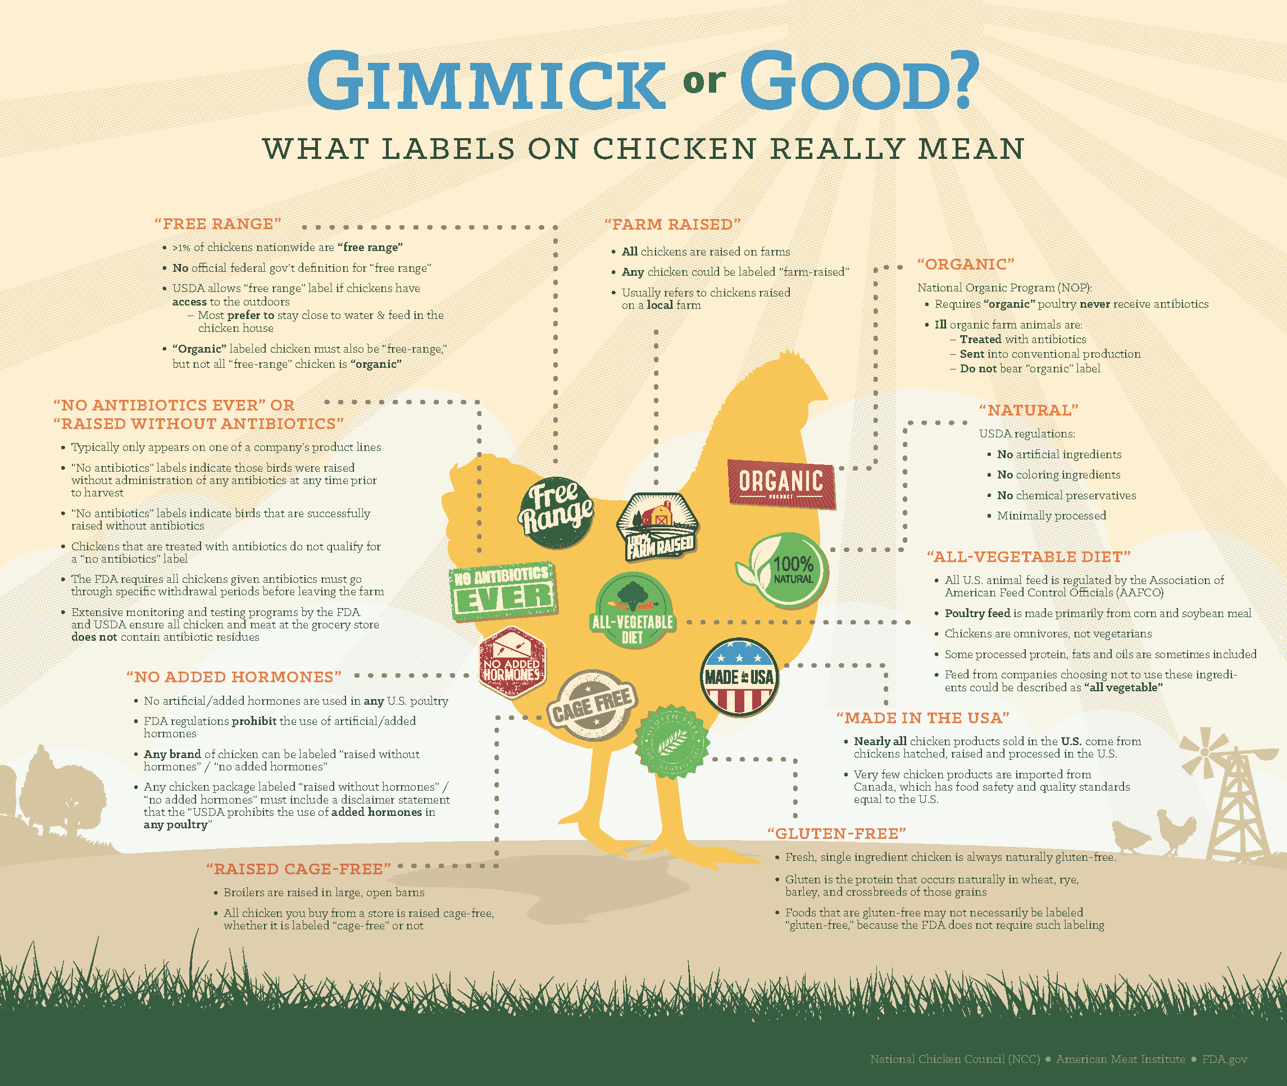

Slide 39
Urban Legends, Myths, and Their Impacts on Consumer Preference
Misinformation can easily form consumer preferences, thus altering production practices of agricultural industries.
This translates into the marketing for these products as well.
  Now let’s take a look at some examples…
  Search online images of various poultry/egg packaging and let’s see if you can notice marketing/label differences in production practices advertised as well as their prices!

Slide 40
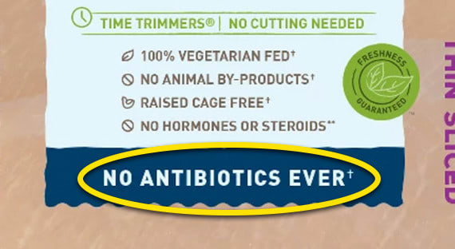
Examples of APPROVED Advertising Claims
“Raised without antibiotics”
“Not fed animal by-products”
“Not fed artificial stimulants”
“Free-range/Free-roaming”
“Raised without added hormones”
  As covered previously, hormones are not and have never been allowed in poultry production.
  Therefore, the claim “No Hormones” cannot be used unless it is followed by a statement that states “Federal regulations prohibit the use of hormones in poultry.”

Slide 41

UNAPPROVED
Advertising Claims
Antibiotic-Free
Hormone-Free
Residue-Free
Drug-Free
Chemical-Free

Slide 42
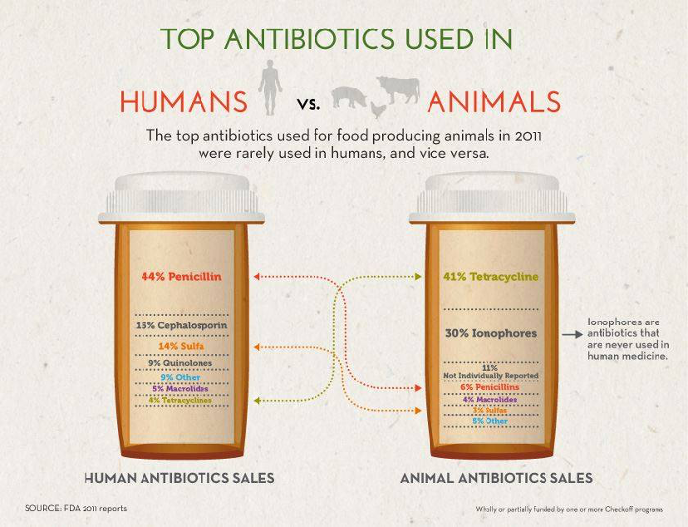
Antibiotic Confusion
Feed withdrawal programs eliminate therapeutic and sub-therapeutic drug residues prior to slaughter.
  Just like withdrawal times, etc. in other livestock!
Classes of antibiotics used for animals and humans vary significantly.

Slide 44
Poultry Science
Curriculum References
Jessica Fife, UGA Dept. of Poultry Science Outreach Coordinator, UGA Dept. of Agricultural Leadership, Education, & Communication MAEE Candidate
Barry Croom, UGA Dept. of Agricultural Leadership, Education, & Communication Professor
Ashley Yopp, UGA Dept. of Agricultural Leadership, Education, & Communication Assistant Professor
Georgia Agriculture Education
Andrew Benson, UGA Dept. of Poultry Science Assistant Professor
Brian Jordan, UGA Dept. of Poultry Science Assistant Professor, UGA College of Veterinary Medicine Assistant Professor
University of Arkansas Bumpers College of Poultry Science – Poultry Science Dual Curriculum Course
Julia Gaskin, UGA Dept. of Crop and Soil Sciences Sr. Public Service Associate
Glendon Harris, UGA Dept. of Crop and Soil Sciences Professor & Extension Agronomist
Brian Kiepper, UGA Dept. of Poultry Science Associate Professor
Claudia Dunkley, UGA Dept. of Poultry Science Public Service Associate
Casey Ritz, UGA Dept. of Poultry Science Professor
USPOULTRY & USPOULTRY Poultry Science Curriculum
Tom Tabler, Mississippi State University Department of Poultry Science Extension Professor
Jacquie Jacob, University of Kentucky
Jeanna Wilson, UGA Dept. of Poultry Science Professor
Kelly Sweeney, UGA Dept. of Poultry Science Ph.D Candidate
Merck Veterinary Manual
University of Maryland Extension
Poultry Hub
Brian Fairchild, University of Georgia Department of Poultry Science Professor
Centers for Disease Control
National FFA Organization

